Slide 1

A* Algorithm for Robot Navigation
Soumit Dey
Reg No: 21201024
Section: A1

Slide 2
Problem Definition
In autonomous robot navigation, the challenge is to find the most efficient path from a start position to a goal while avoiding obstacles. The A* algorithm solves this by combining actual movement cost and estimated cost to reach the goal.

Slide 3
A* Algorithm Formula
The cost function of A* is defined as:
f(n) = g(n) + h(n)
Where:
- f(n): Total cost of the node
- g(n): Cost from the start node to the current node
- h(n): Heuristic estimate from the current node to the goal

Slide 4
Distance Formula
I use Manhattan Distance to calculate heuristic distance h(n). The Manhattan Distance is calculated as:
h(n) = |x1 - x2| + |y1 - y2|
This heuristic is ideal for grid-based maps where movement is restricted to horizontal and vertical directions.

Slide 5
Final Calculation
When the path is straight(left, right , up and down) then calculation:
f(n)= current cell cost + h(n)
When the path is diagonal , then calculation:
f(n)= 1.4 X current cell cost + h(n).

Slide 6
Grid Calculation
My last two digit 24 . So the sum is 2+4=6 .
Since , 6<10
then grid size will 6+5=11.

Slide 7
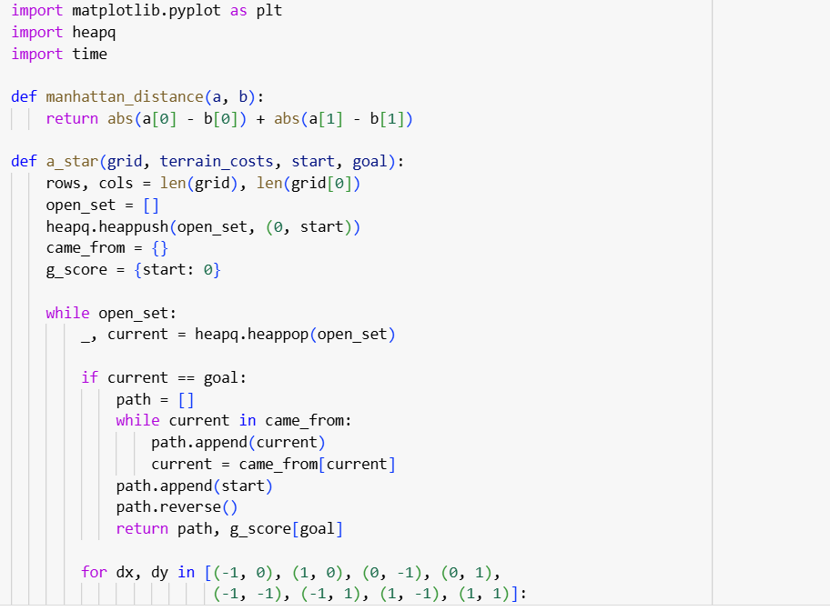
Code

Slide 8
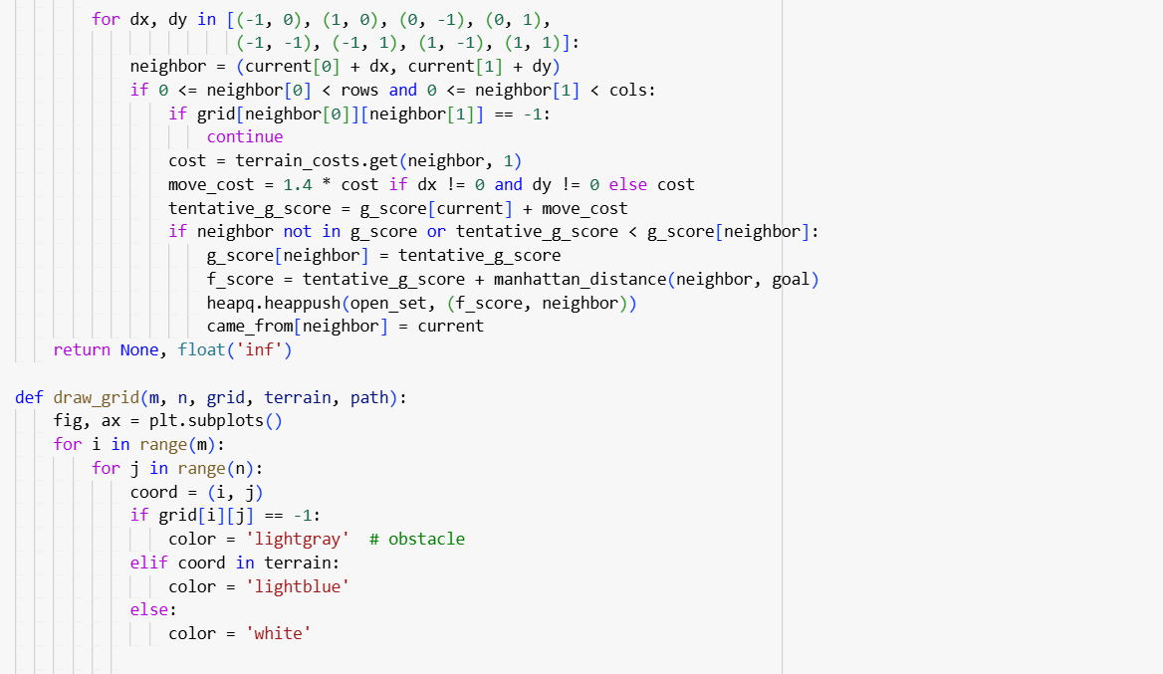

Slide 9
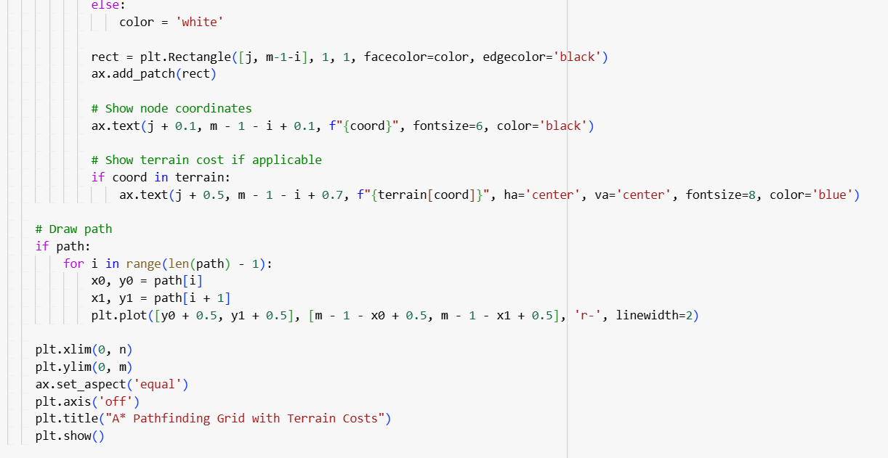

Slide 10
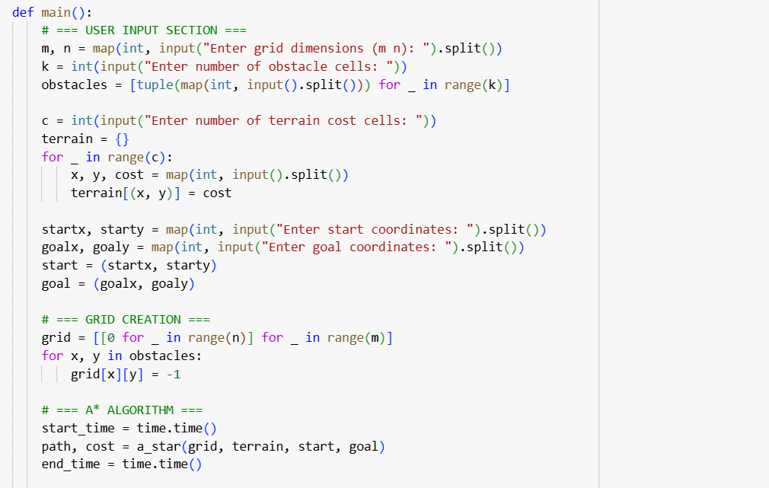

Slide 11
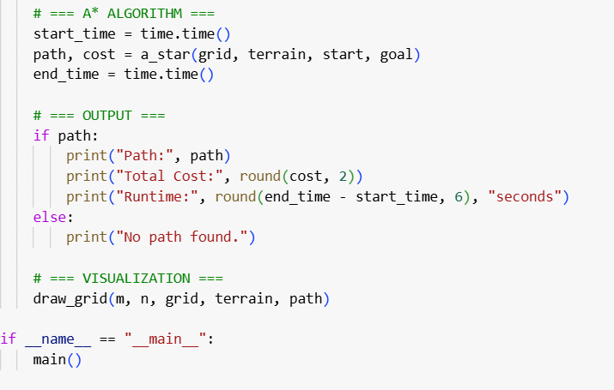

Slide 12
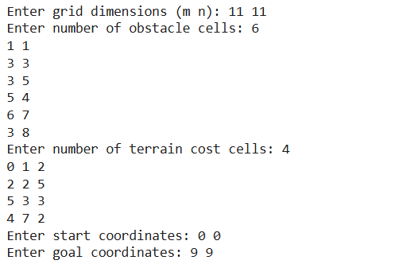
Input

Slide 13
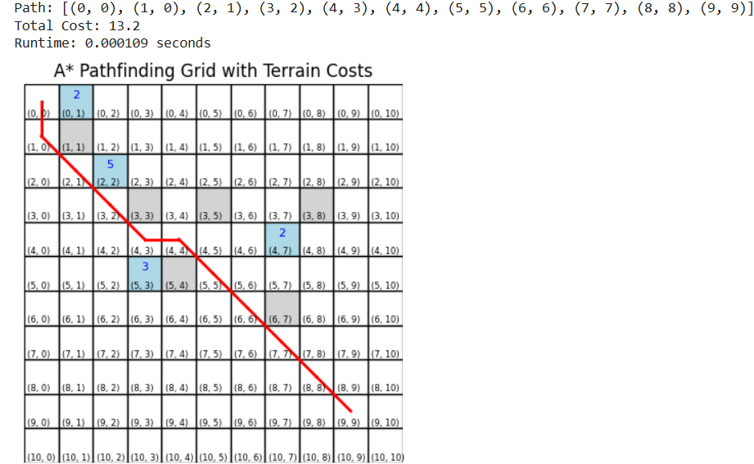
Output with Figure

Slide 14
Thank You

